Slide 1
Large-Scale and Multi-Structured Databases
Project Design
<title>
<authors>

Slide 2
Application Highlights
Distributed Video Games Social Media
Game Discovery
Browse trending, top-rated and recommended games
Search by title, genre, category, OS etc.
Order search results by name, rating, price and release date
See reviews, positive rating percentage and games' popularity
Users' Experience
Add games to the “playing” and “played” list
Submit reviews (like/dislike + description) for played games
Send friend requests, accept friendships and explore friends' profiles
Get personalized game recommendations based on your preferences
Administrative Operations
Moderate users' behaviors (delete inappropriate reviews, ban or delete users)
Add and remove games, genres and categories from the catalogue

Slide 3
Actors and main mock-ups (i)
Identify actors and draw preliminary mock-ups of the application

Slide 4
Actors and main mock-ups (ii)
Identify actors and draw preliminary mock-ups of the application (use as many slides as needed)

Slide 5
Dataset Description
Source:
Description:
Volume:
Variety:
Velocity/Variability:

Slide 6
Preliminary UML Class Diagram

Slide 7
Relevant Queries and Entities handled by Document DB
List the most relevant functional requirements supported by the Document DB
The system must compute ratings for games
The system must find the highest rated games by genre/category/publisher
The system must allow admin to ban/delete users
The system must find the current trending games
List which are the entities stored in the Document DB
Game
User
Review

Slide 8
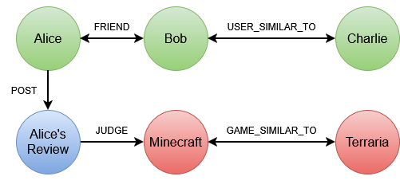
Requirements and Entities handled by Graph DB
List the most relevant functional requirements supported by the Graph DB
The system must recommend games similar to those played by the user
The system must allow the creation of friendships between users
The system must allow a user to view another user's profile
The system must display the friends who have played a specified game
The system must recommend games played by users similar to the current user
List which are the entities stored by the Graph DB
Game
User
Review

